Slide 1
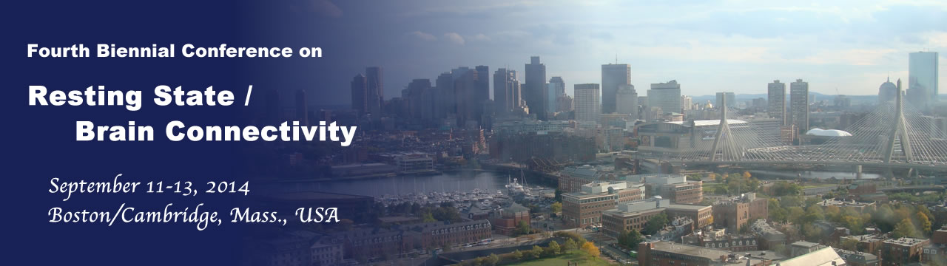

On the intimate relationship between functional and effective connectivity
Karl Friston, Wellcome Centre for Neuroimaging
The past decade has seen tremendous advances in characterising functional integration in the brain; especially in the resting state community. Much of this progress is set against the backdrop of a key dialectic between functional and effective connectivity. I hope to highlight the intimate relationship between functional and effective connectivity and how one informs the other. My talk will focus on the application of dynamic causal modelling to resting state timeseries or endogenous neuronal activity. I will survey recent (and rapid) developments in modelling distributed neuronal fluctuations (e.g., stochastic, spectral and symmetric DCM for fMRI) – and how this modelling rests upon functional connectivity. This survey concludes by looking at the circumstances under which functional and effective connectivity can be regarded as formally identical. I will try to contextualise these developments in terms of some historical distinctions that have shaped our approaches to connectivity in functional neuroimaging.

Slide 2

Dinner Speaking [edit]
The Dinner speech should not resort to the base forms of humor. The humor should be topical and relevant to the idea presented. This type of speech is found at the collegiate level and is typically eight to ten minutes long.

Slide 3
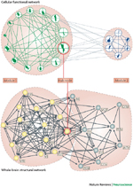
The past decade has seen tremendous advances in characterising functional integration in the brain; especially in the resting state community. Much of this progress is set against the backdrop of a key dialectic between functional and effective connectivity. I hope to highlight the intimate relationship between functional and effective connectivity and how one informs the other. My talk will focus on the application of dynamic causal modelling to resting state timeseries or endogenous neuronal activity. I will survey recent (and rapid) developments in modelling distributed neuronal fluctuations (e.g., stochastic, spectral and symmetric DCM for fMRI) – and how this modelling rests upon functional connectivity. This survey concludes by looking at the circumstances under which functional and effective connectivity can be regarded as formally identical. I will try to contextualise these developments in terms of some historical distinctions that have shaped our approaches to connectivity in functional neuroimaging.

Slide 4
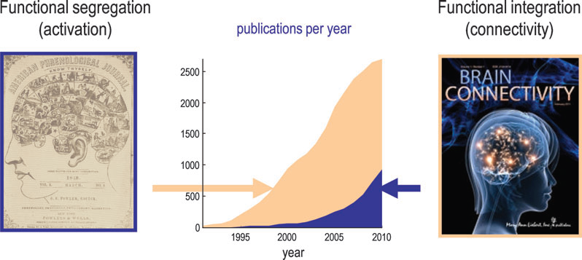

Slide 5
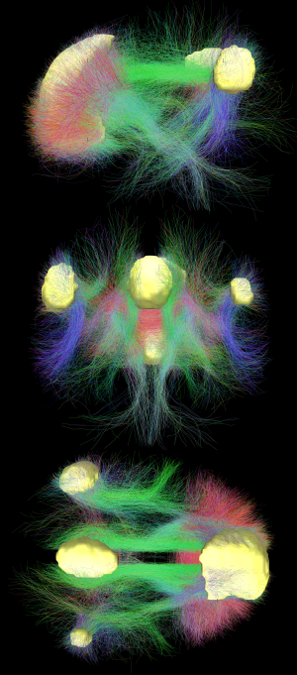
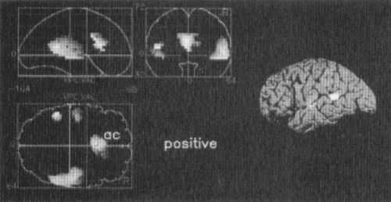
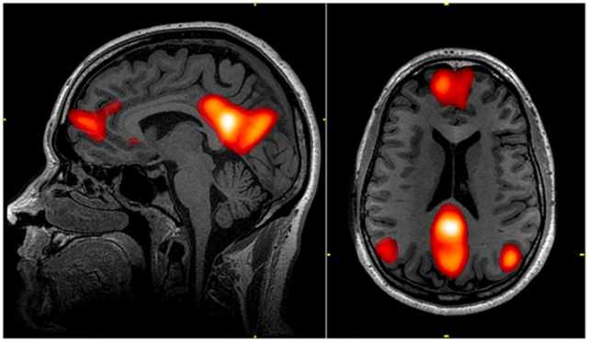

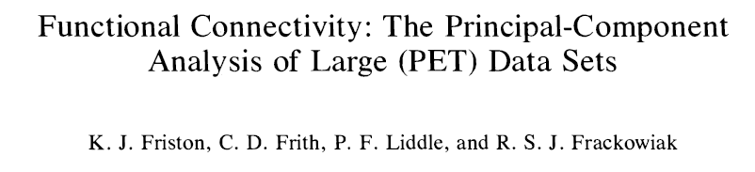
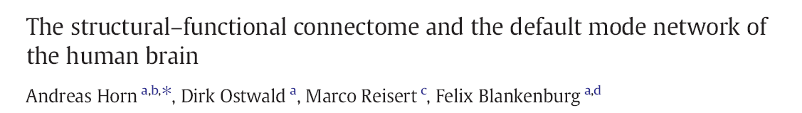
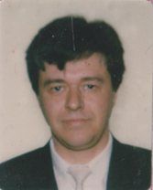

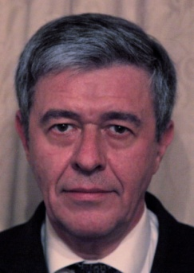


Circa 1993
Circa 2013

Slide 6



“Why did you guy’s drop the ball with functional connectivity?”
Michael D. Fox, MD, PhD

Slide 7
The past decade has seen tremendous advances in characterising functional integration in the brain; especially in the resting state community. Much of this progress is set against the backdrop of a key dialectic between functional and effective connectivity. I hope to highlight the intimate relationship between functional and effective connectivity and how one informs the other. My talk will focus on the application of dynamic causal modelling to resting state timeseries or endogenous neuronal activity. I will survey recent (and rapid) developments in modelling distributed neuronal fluctuations (e.g., stochastic, spectral and symmetric DCM for fMRI) – and how this modelling rests upon functional connectivity. This survey concludes by looking at the circumstances under which functional and effective connectivity can be regarded as formally identical. I will try to contextualise these developments in terms of some historical distinctions that have shaped our approaches to connectivity in functional neuroimaging.

Slide 8
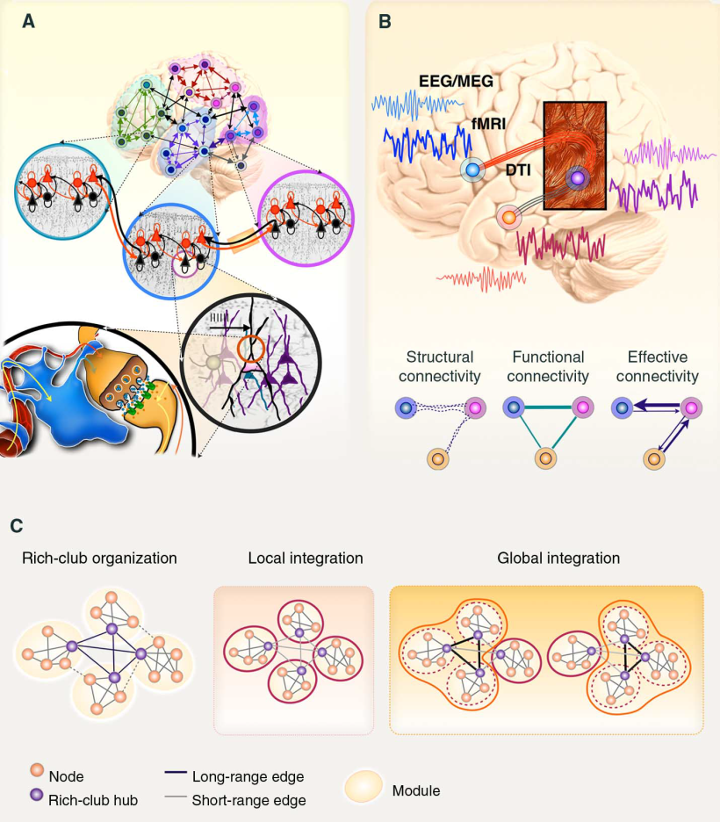
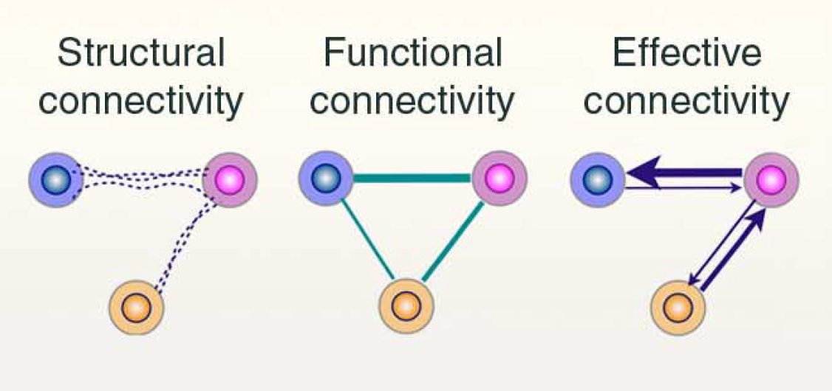
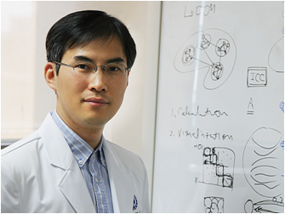
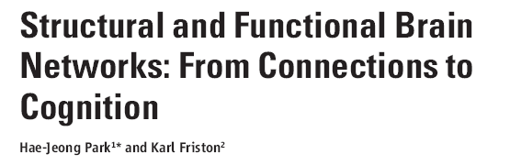

Slide 9
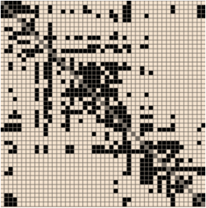
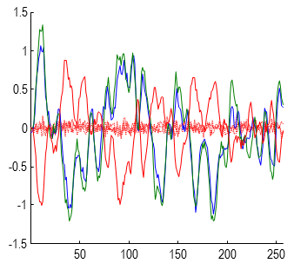
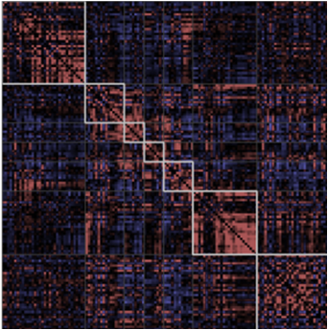
The forward (dynamic causal) model
Endogenous fluctuations
Effective connectivity
Observed timeseries
Functional connectivity

Slide 10
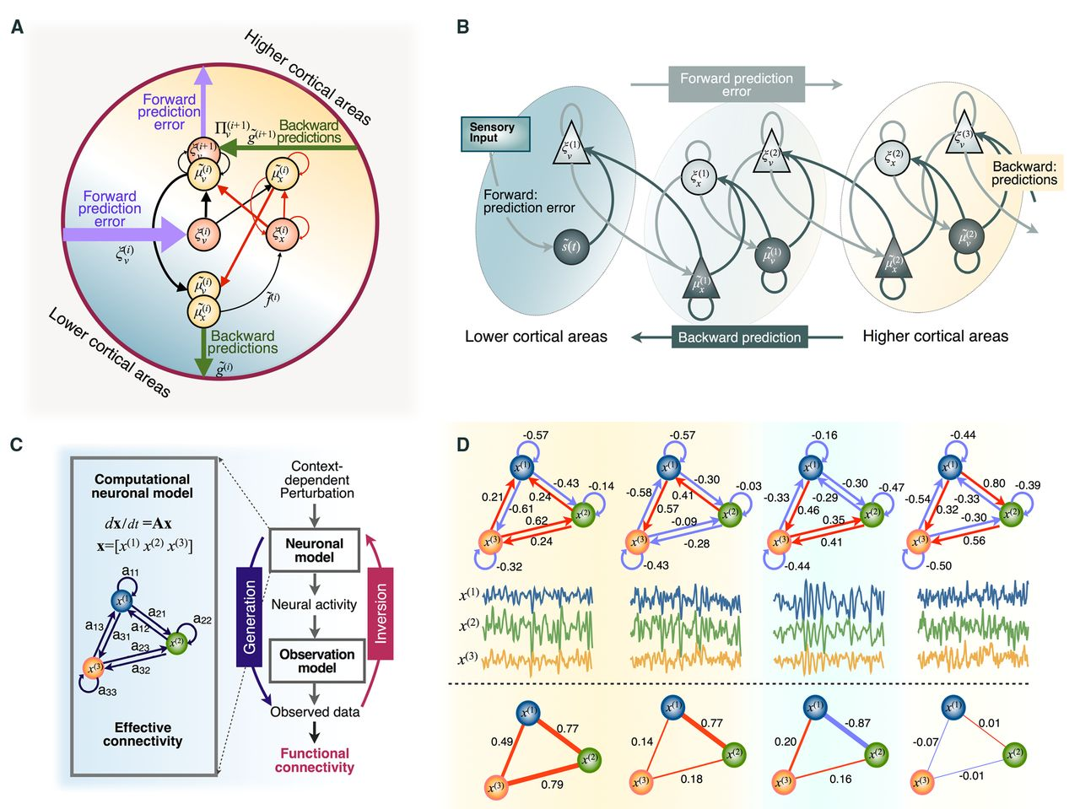
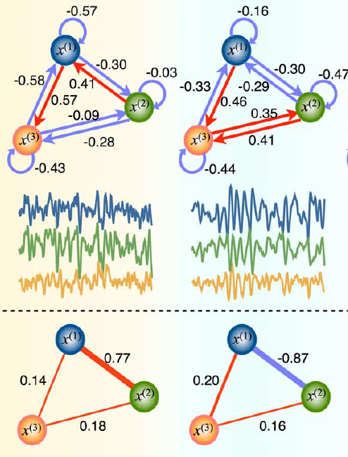
A connectivity reconstruction problem:
A degenerate (many-to-one) mapping between effective and functional connectivity

Slide 11
The forward (dynamic causal) model
Endogenous fluctuations
Effective connectivity
Observed timeseries
Functional connectivity

Slide 12

Bayesian model inversion
Endogenous fluctuations
Posterior density
Effective connectivity
Log model evidence
(Free energy)
Observed timeseries
Functional connectivity
Richard Feynman

Slide 13
Bayesian model inversion
Endogenous fluctuations
Posterior density
Bayesian model comparison
Log model evidence
Bayesian model averaging

Slide 14
Bayesian model inversion
Model evidence and Ockham’s principle
Posterior density
Accuracy
Complexity
Evidence is afforded by data …
Log model evidence
fMRI data
EEG data
EEG models
Complexity
fMRI models

Slide 15

Bayesian model reduction
Armani, Calvin Klein and Versace design houses did not refuse this year to offer very brave and reduced models of the “Thong” and “Tango”. The designers consider that a man with the body of Apollo should not obscure the wonderful parts of his body.
And the concept of reduced models
This means that we only have to invert the full model to score all reduced models;
c.f., the Savage-Dickey density ratio

Slide 16
And recovering (discovering) the true architecture
True and MAP connections
Log-evidence
0.4
100
0.2
0
Simulating the response of a four-node network
-100
0
-200
log-probability
-0.2
-300
-400
-0.4
-500
-0.6
0
5
10
15
-600
0
10
20
30
40
50
60
model
Log-evidence
Model posterior
100
1
0
0.8
-100
-200
0.6
log-probability
probability
-300
0.4
-400
-500
0.2
-600
0
1
2
3
4
5
6
0
0
10
20
30
40
50
60
graph size
model
Complexity

Slide 17
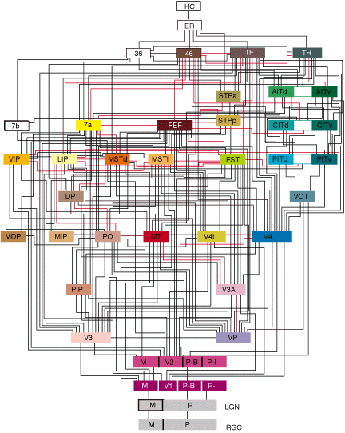
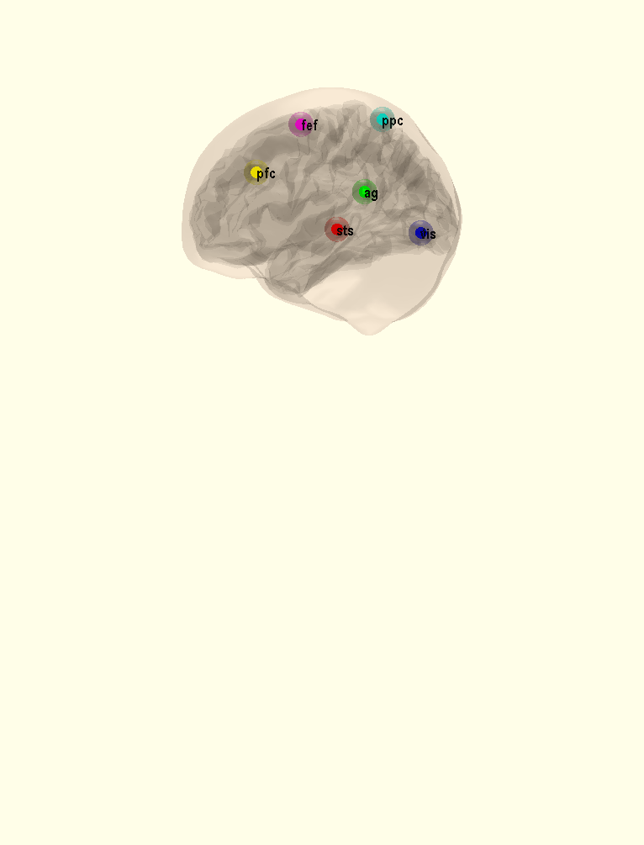
An empirical example (with six nodes)
Log- evidence
fef: responses
100
5
0
0
-5
0
200
400
600
800
1000
1200
-100
5
ag: responses
log-probability
0
-200
-5
0
200
400
600
800
1000
1200
-300
2
ppc: responses
0
-400
0
0.5
1
1.5
2
2.5
3
3.5
-2
x 10
4
-4
0
200
400
600
800
1000
1200
Model posterior
5
pfc: responses
0.9
Differences in reciprocal connectivity
0
0.8
-5
0
200
400
600
800
1000
1200
0.7
sts: responses
0.6
0.00 0.00 -0.57 -0.28 -0.17 -0.31
0.00 0.00 -0.34 0.00 -0.37 -0.42
0.57 0.34 0.00 -0.45 -0.43 -0.51
0.28 0.00 0.45 0.00 0.00 -0.25
0.17 0.37 0.43 0.00 0.00 -0.28
0.31 0.42 0.51 0.25 0.28 0.00
'vis' 'sts' 'pfc' 'ppc' 'ag' 'fef'
4
0.5
2
probability
0.4
0
0.3
-2
0
200
400
600
800
1000
1200
2
vis: responses
0.2
0
0.1
-2
0
0
0.5
1
1.5
2
2.5
3
3.5
-4
0
200
400
600
800
1000
1200
model
x 10
4
time {seconds}

Slide 18
The past decade has seen tremendous advances in characterising functional integration in the brain; especially in the resting state community. Much of this progress is set against the backdrop of a key dialectic between functional and effective connectivity. I hope to highlight the intimate relationship between functional and effective connectivity and how one informs the other. My talk will focus on the application of dynamic causal modelling to resting state timeseries or endogenous neuronal activity. I will survey recent (and rapid) developments in modelling distributed neuronal fluctuations (e.g., stochastic, spectral and symmetric DCM for fMRI) – and how this modelling rests upon functional connectivity. This survey concludes by looking at the circumstances under which functional and effective connectivity can be regarded as formally identical. I will try to contextualise these developments in terms of some historical distinctions that have shaped our approaches to connectivity in functional neuroimaging.

Slide 19
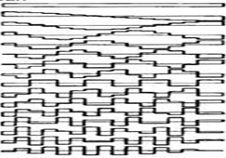
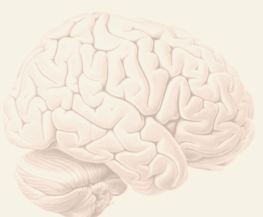
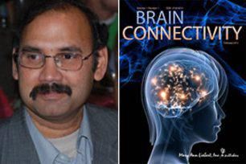
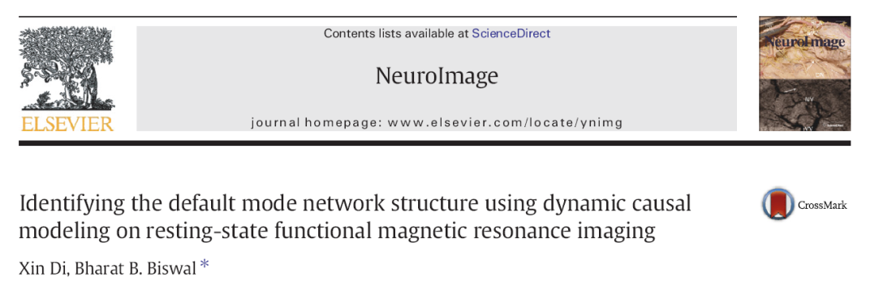
The forward (dynamic causal) model
Endogenous fluctuations
Endogenous fluctuations
Deterministic DCM
Observed timeseries

Slide 20
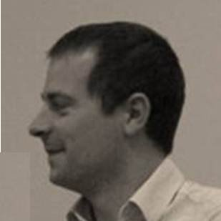
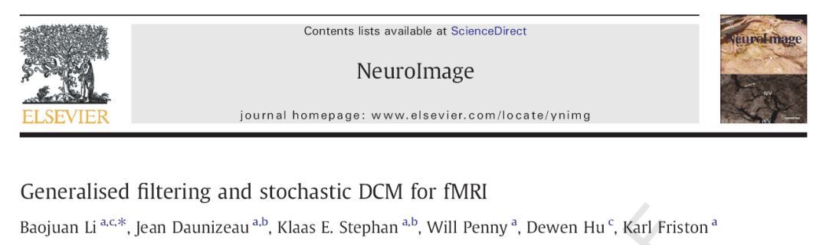

The forward (dynamic causal) model
Endogenous fluctuations
Stochastic DCM
Observed timeseries

Slide 21
Simulated responses of a three node network
0.8
True and MAP connections
0.6
0.4
1.5
Signal and noise
0.2
Hidden states
0.2
1
0.15
0
0.1
-0.2
0.5
0.05
-0.4
0
0
-0.6
-0.5
-0.05
-0.8
1
2
3
4
5
6
7
8
9
-1
-0.1
Extrinsic coupling parameter
-0.15
Deterministic DCM
-1.5
50
100
150
200
250
-0.2
50
100
150
200
250
time
time
0.2
Hidden causes
Network or graph generating data
True and MAP connections
Hidden states
0.5
0.2
0.15
0.15
0.1
0.1
0.05
0.05
0
0
0
-0.05
-0.05
-0.1
-0.1
-0.15
-0.15
50
100
150
200
250
-0.5
1
2
3
4
5
6
7
8
9
-0.2
50
100
150
200
250
time
Extrinsic coupling parameter
time (bins)
Stochastic DCM

Slide 22
The forward (dynamic causal) model
Endogenous fluctuations
Spectral DCM
Observed timeseries

Slide 23
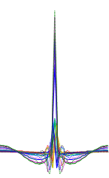
The forward (dynamic causal) model
Endogenous fluctuations
Spectral DCM

Slide 24
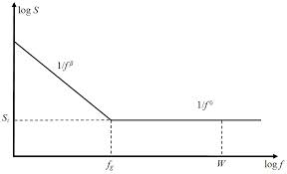
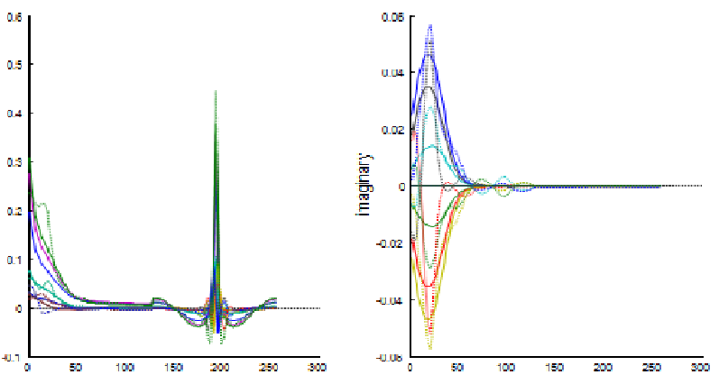
The forward (dynamic causal) model
Endogenous fluctuations
Spectral DCM
Complex cross-spectra

Slide 25
Simulated responses of a three node network
0.4
True and MAP connections
0.3
0.2
Endogenous fluctuations
Hidden states
0.1
0.4
0.1
0.3
0
0.2
0.05
0.1
-0.1
amplitude
0
amplitude
0
-0.2
-0.1
-0.05
-0.3
-0.2
-0.3
0
50
100
150
200
250
300
-0.1
0
50
100
150
200
250
300
-0.4
1
2
3
4
5
6
7
8
9
time (seconds)
time (seconds)
Prediction and response
Hemodynamic response and noise
Network or graph generating data
0.6
0.06
0.6
Region 3
0.5
0.4
0.04
0.2
0.2
-0.3
0.4
amplitude
0
0.02
-0.2
Region 2
0.3
real
imaginary
-0.4
0.4
-0.2
0
-0.6
0.2
-0.8
Region 1
0.1
-0.02
0
50
100
150
200
250
300
time (seconds)
0
-0.04
-0.1
0
50
100
150
200
250
300
-0.06
0
50
100
150
200
250
300
Frequency and time (bins)
Frequency and time (bins)

Slide 26
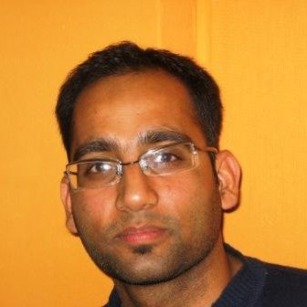
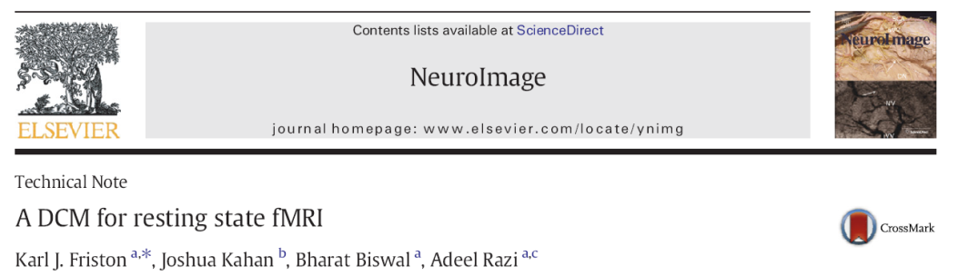
The effect of scan length:
True and MAP connections (BPA: 1024 scans)
Root mean square error
0.4
0.35
0.3
0.3
0.2
0.25
0.1
0
0.2
-0.1
RMS
0.15
-0.2
0.1
-0.3
1
2
3
4
5
6
7
8
9
0.05
0
0.4
True and MAP connections (BPA: 256 scans)
128
256
384
512
640
768
896
1024
Session length (scans)
0.3
0.2
0.1
0
-0.1
-0.2
-0.3
1
2
3
4
5
6
7
8
9

Slide 27
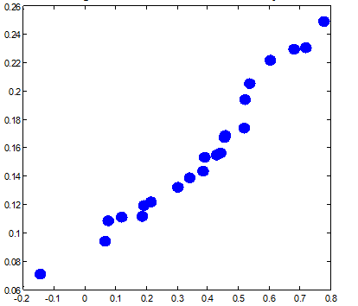
Simulations
Empirical
0.35
0.3
1
Spectral
0.8
stochastic
0.25
Accuracy
0.2
0.6
0.15
0.4
spectral
Posterior expectation (Hz)
0.1
0.2
0.05
0
0
-0.2
Strongest connection
128
256
384
512
640
768
896
1024
Comparing spectral and stochastic DCM
-0.4
0
5
10
15
20
0.35
Subjects
0.25
0.3
0.2
Stochastic
0.25
0.15
0.2
Accuracy
Posterior expectation (Hz)
0.15
0.1
0.1
0.05
0.05
0
0
0
5
10
15
20
128
256
384
512
640
768
896
1024
Session length (scans)
Subjects

Slide 28
Dynamic causal model
Convolution kernel representation
Functional Taylor expansion
Spectral representation
Convolution theorem
Autoregressive representation
Yule Walker equations
Spectral representation
Convolution theorem
Cross-covariance
Cross-spectral density
Auto-regression coefficients
Directed transfer functions
Cross-correlation
Coherence
Auto-correlation
Granger causality
Second-order data features (functional connectivity)

Slide 29
The past decade has seen tremendous advances in characterising functional integration in the brain; especially in the resting state community. Much of this progress is set against the backdrop of a key dialectic between functional and effective connectivity. I hope to highlight the intimate relationship between functional and effective connectivity and how one informs the other. My talk will focus on the application of dynamic causal modelling to resting state timeseries or endogenous neuronal activity. I will survey recent (and rapid) developments in modelling distributed neuronal fluctuations (e.g., stochastic, spectral and symmetric DCM for fMRI) – and how this modelling rests upon functional connectivity. This survey concludes by looking at the circumstances under which functional and effective connectivity can be regarded as formally identical. I will try to contextualise these developments in terms of some historical distinctions that have shaped our approaches to connectivity in functional neuroimaging.

Slide 30
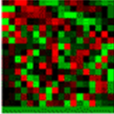

The forward (dynamic causal) model
Endogenous fluctuations
What if the connectivity was symmetrical?
Symmetrical DCM

Slide 31
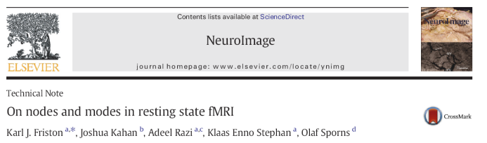
The forward (dynamic causal) model
Endogenous fluctuations
Symmetrical DCM

Slide 32
The forward (dynamic causal) model
Endogenous fluctuations
Symmetrical DCM
In the absence of measurement noise, effective connectivity becomes the negative inverse functional connectivity

Slide 33
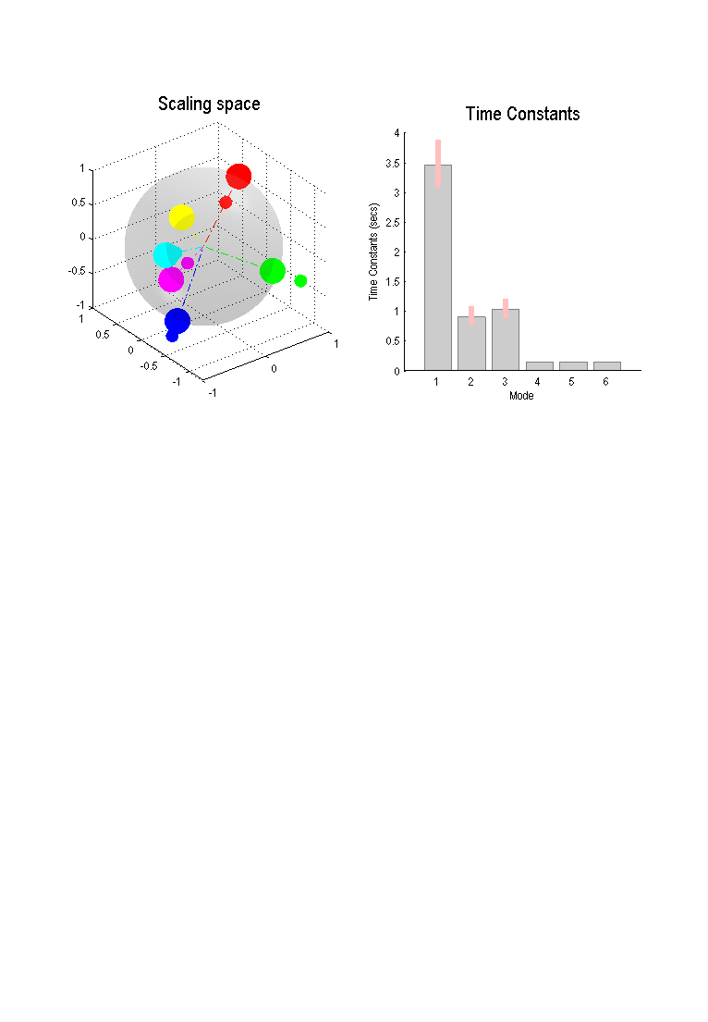
The number of slow (unstable) modes and their time constants
5
fef: responses
Embedding (empirical)
0
70
-5
60
0
200
400
600
800
1000
1200
50
5
ag: responses
40
0
Free energy
30
-5
0
200
400
600
800
1000
1200
20
2
ppc: responses
10
0
0
1
2
3
4
5
-2
Embedding dimension
-4
0
200
400
600
800
1000
1200
5
pfc: responses
0
-5
0
200
400
600
800
1000
1200
4
sts: responses
2
0
-2
0
200
400
600
800
1000
1200
2
vis: responses
0
-2
-4
0
200
400
600
800
1000
1200
time {seconds}

Slide 34

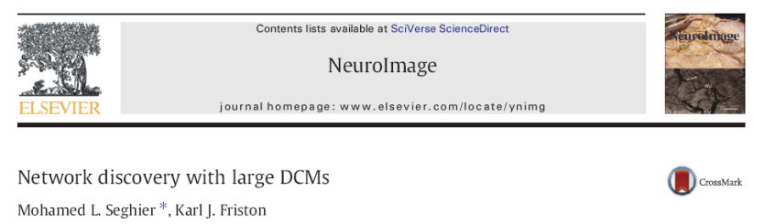
The forward (dynamic causal) model
Endogenous fluctuations
Breaking the symmetry:
Large DCMs

Slide 35
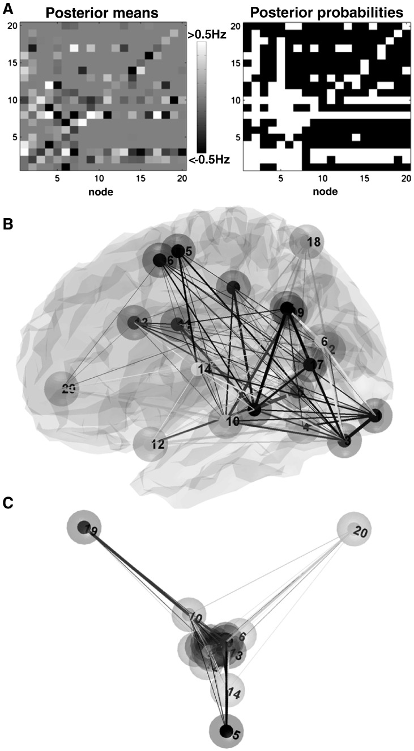
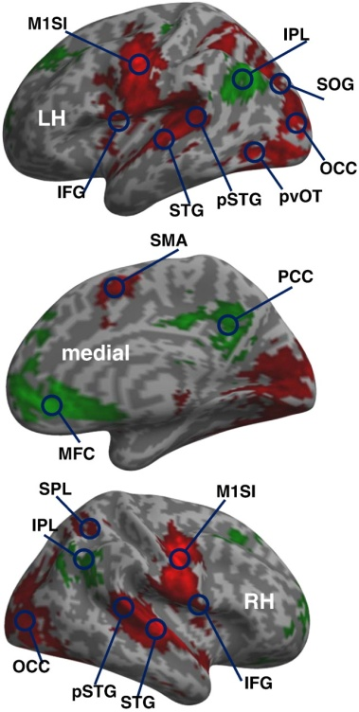
The forward (dynamic causal) model
Log evidence
Accuracy
Complexity
Principal modes in the language system
Number of modes (m)

Slide 36
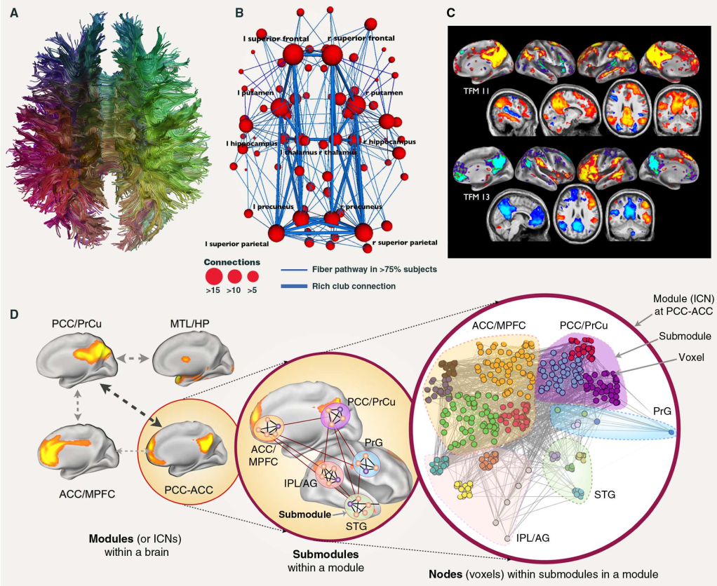
Nature uses only the longest threads to weave her patterns, so each small piece of her fabric reveals the organization of the entire tapestry.
  chapter 1, “The Law of Gravitation,” p. 34
Richard Feynman

Slide 37
Thank you
And thanks to
Bharat Biswal
Christian Büchel
CC Chen
Jean Daunizeau
Olivier David
Marta Garrido
Sarah Gregory
Lee Harrison
Joshua Kahan
Stefan Kiebel
Baojuan Li
Andre Marreiros
Rosalyn Moran
Hae-Jeong Park
Will Penny
Adeel Razi
Mohamed Seghier
Klaas Stephan
And many others

